Slide 1

ISE 218: Fundamentals of Information Technology Unit 5: Memory
Spring 2025
Instructor: Abid Malik
co-Instructor: Xinrui Yu

Slide 2
Introduction
Memory lies at the heart of the stored-program (von Neumann-style) computer.
In previous Units, we studied the components from which memory is built and the ways in which memory is accessed by various ISAs.
In this Unit, we focus on memory organization. A clear understanding of these ideas is essential for the analysis of system performance.

Slide 3
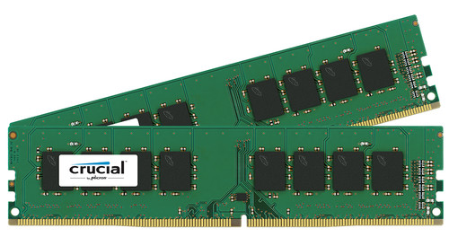
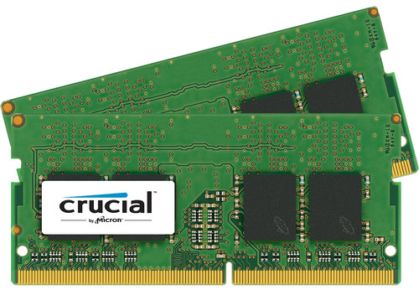
Types of Memory
There are two kinds of main memory: random access memory, RAM, and read-only-memory, ROM.
There are two types of RAM, dynamic RAM (DRAM) and static RAM (SRAM).
DRAM consists of capacitors that slowly leak their charge over time.
Thus, they must be refreshed every few milliseconds to prevent data loss.
DRAM is “cheap” memory, owing to its simple design.
Desktop RAM vs. laptop RAM:
Notes:
DRAM made a capacitors, it refresh every millisecond
SRAM for cache memory very fast and doesn’t need to be refreshed

Slide 4
Types of Memory
SRAM is very fast memory and it doesn’t need to be refreshed like DRAM does, but does need a constant supply of power. It is used to build cache memory, which we will explore later.
Briefly, cache memory is very high-speed memory that helps to make modern computers so fast
ROM also does not need to be refreshed, either.
ROM is used to store permanent or semi-permanent data that persists even while the system is turned off.
For example, the program that boots the computer when the computer is turned on is stored in a ROM chip.

Slide 5
The Memory Hierarchy
Generally speaking, faster memory is more expensive than slower memory.
To provide the best performance at the lowest cost, memory is organized in a hierarchical fashion.
Small, fast storage elements are kept in the CPU, while larger, slower main memory is accessed through the data bus.
Larger, (almost) permanent storage in the form of disk and tape drives is yet further from the CPU.

Slide 6
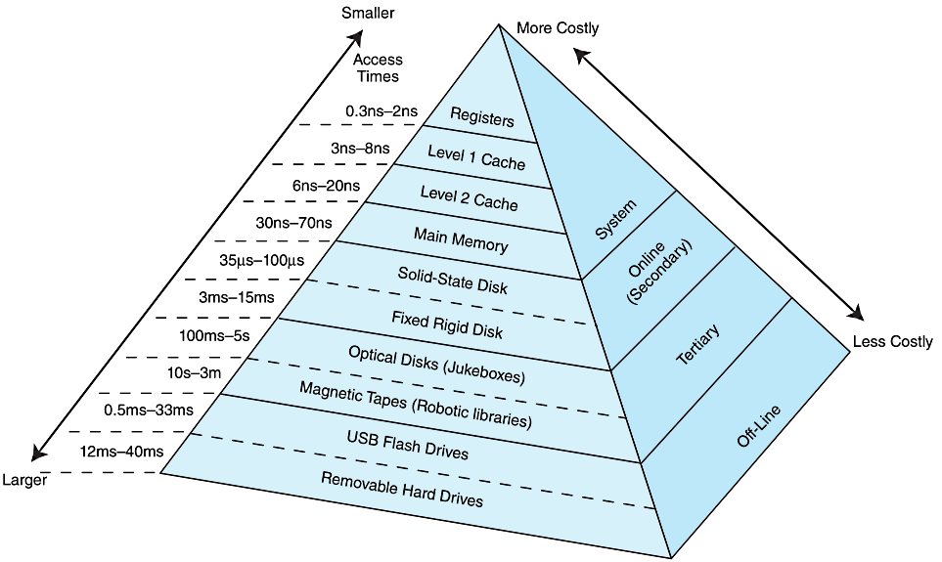
The Memory Hierarchy

Slide 7
The Memory Hierarchy
We are most interested in the memory hierarchy that involves registers, cache, main memory, and virtual memory.
Registers are storage locations available on the processor itself.
Virtual memory is typically implemented using a hard drive; it extends the address space from RAM to the hard drive.
Virtual memory provides more space, whereas cache memory provides speed.
More on virtual memory a little later.

Slide 8

The Memory Hierarchy
In enterprise systems (e.g., the software that runs large corporations), backups are held in tertiary storage
These backup systems can consist of many tapes and optical disks that are retrieved using robotic systems
archive.boston.com/bigpicture/2009/11/large_hadron_collider_ready_to.html

Slide 9
The Memory Hierarchy
While a computer is running, for the CPU to access a particular piece of data, it first sends a request to its nearest memory, usually cache.
If the data is not in cache, then main memory is checked. If the data is not in main memory, then the request goes to disk.
Disk is a form of secondary storage
Once the data is located, then the data, and a number of its nearby data elements are fetched into cache memory.
This leads us to some definitions:
A hit is when data is found at a given memory level.
A miss is when it is not found.
The hit rate is the percentage of time data is found at a given memory level.
The miss rate is the percentage of time it is not. (miss rate = 1 – hit rate.)

Slide 10
The Memory Hierarchy
Some additional definitions:
The hit time is the time required to access data at a given memory level.
The miss penalty is the time required to process a miss, including the time that it takes to replace a block of memory plus the time it takes to deliver the data to the processor.
We want the hit rate to be as high as possible and the hit time (and miss penalty) to be as low as possible
We’ll do some calculations involving these values towards the end of the Unit

Slide 11
The Memory Hierarchy
An entire block of data is copied after a hit because the principle of locality tells us that once a byte is accessed, it is likely that nearby data elements will be needed soon also
This clustering of memory references into groups is an example of locality of reference
There are three forms of locality:
Temporal locality: recently-accessed data elements tend to be accessed again.
Spatial locality: accesses tend to cluster in memory.
Sequential locality: instructions tend to be accessed sequentially.

Slide 12
The Memory Hierarchy
Locality of reference suggests that we should retrieve blocks of data at once, not individual bytes or words
It will generally require less time to retrieve a single block of data from memory (a few words, let’s say) than to make several, independent retrievals of single words from memory
We make one round-trip across the system bus between the CPU and main memory rather than several

Slide 13
Cache Memory
The purpose of cache memory is to speed up accesses by storing recently used data closer to the CPU, instead of storing it in main memory, which is about one order of magnitude slower (~10x slower).
Although cache is much smaller than main memory, its access time is a fraction of that of main memory.
A typical computer has several levels of cache: L1, L2 and L3
L1 (~8K – 64K) is the smallest and fastest cache. It is “closest” to the CPU. Next come L2 and then L3, which are progressively slower, but larger in size.

Slide 14
Cache Memory
When the CPU generates a memory address, cache is checked first to see if the data value is available there
If the value is not in the cache, then the block of memory containing that value is copied into a block of cache (the memory/cache block sizes are equal)
The address of the data in memory is generally not the address of the data in the cache
The main memory address must be mapped to an address in the cache
There are several ways of performing this mapping, but we will look at only two

Slide 15
Cache Memory: Direct Mapped Cache
The simplest cache mapping scheme is direct mapped cache.
In a direct mapped cache consisting of N blocks of cache, block X of main memory maps to cache block Y = X mod N.
mod stands for modulo or modulus
The notation X mod N means “give me the remainder of X divided by N”.
Thus, if we have 10 blocks of cache, block 7 of cache could hold blocks 7, 17, 27, 37, ... of main memory.
With direct mapped cache consisting of N blocks of cache, block X of main memory maps to cache block Y = X mod N.

Slide 16
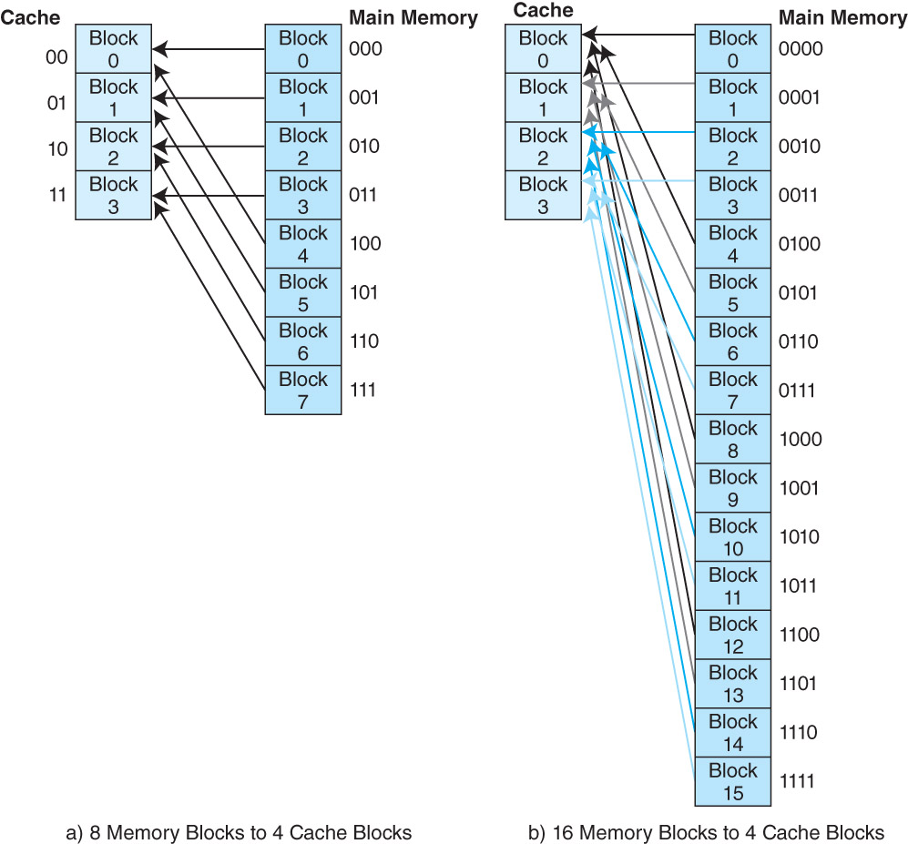
Direct Mapped Cache: Example #1

Slide 17
Direct Mapped Cache: Example #2

Slide 18
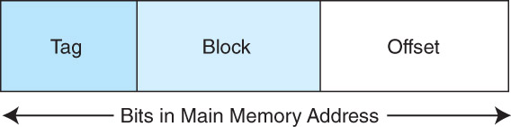
Direct Mapped Cache
To perform direct mapping, a binary main memory address is partitioned into the fields shown below.
The offset field uniquely identifies an address within a specific block.
The block field selects a unique block of cache.
The tag field is whatever is leftover.
The sizes of these fields are determined by characteristics of both memory and cache.

Slide 19
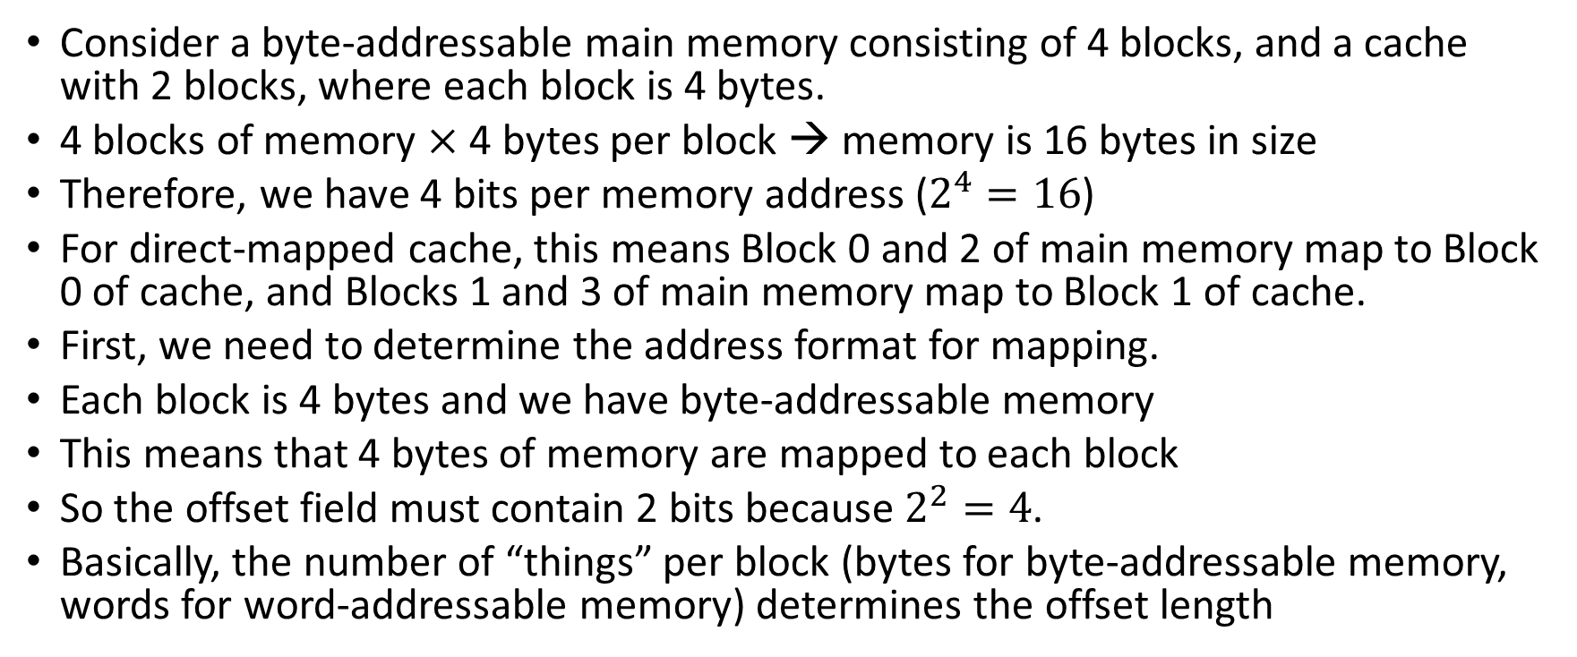
Direct Mapped Cache: Example #3
Consider a byte-addressable main memory consisting of 4 blocks, and a cache with 2 blocks, where each block is 4 bytes.
4 blocks of memory $×$ 4 bytes per block → memory is 16 bytes in size
Therefore, we have 4 bits per memory address ($2^{4}=16$)
For direct-mapped cache, this means Block 0 and 2 of main memory map to Block 0 of cache, and Blocks 1 and 3 of main memory map to Block 1 of cache.
First, we need to determine the address format for mapping.
Each block is 4 bytes and we have byte-addressable memory
This means that 4 bytes of memory are mapped to each block
So the offset field must contain 2 bits because $2^{2}=4$.
Basically, the number of “things” per block (bytes for byte-addressable memory, words for word-addressable memory) determines the offset length

Slide 20
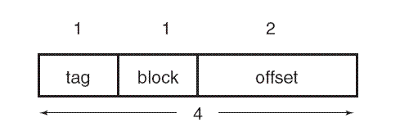
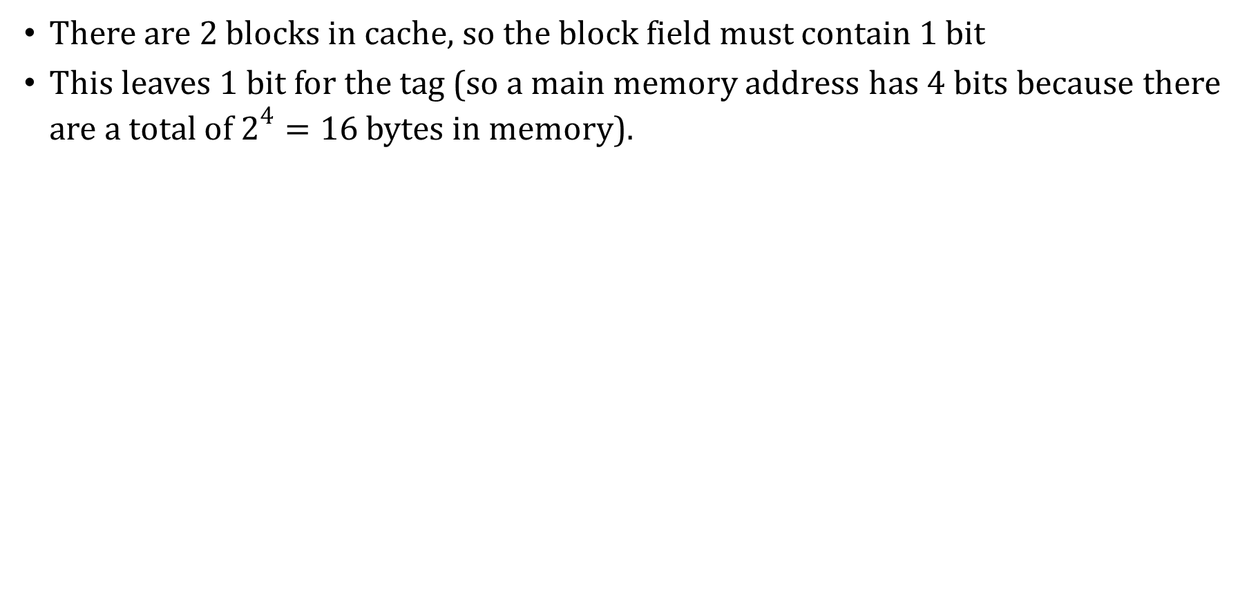
Direct Mapped Cache: Example #3
There are 2 blocks in cache, so the block field must contain 1 bit
This leaves 1 bit for the tag (so a main memory address has 4 bits because there are a total of $2^{4}=16$ bytes in memory).

Slide 21
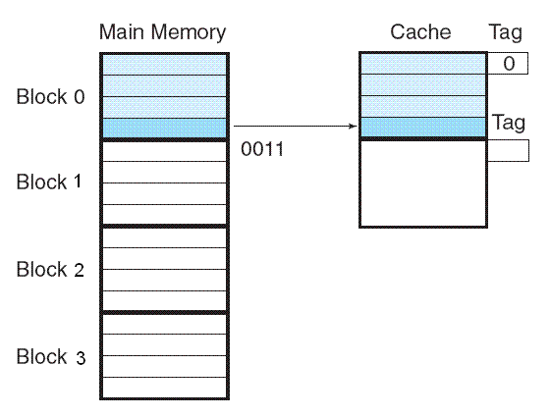
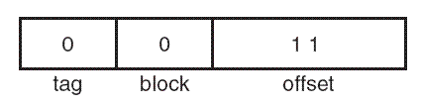
Direct Mapped Cache: Example #3
Suppose we need to access main memory address 3₁₆ (0011 in binary). If we partition 0011 using the address format from Figure A, we get Figure B.
Thus, the main memory address 0011 maps to cache block 0.
Figure C shows this mapping, along with the tag that is also stored with the data.
A
B
C

Slide 22
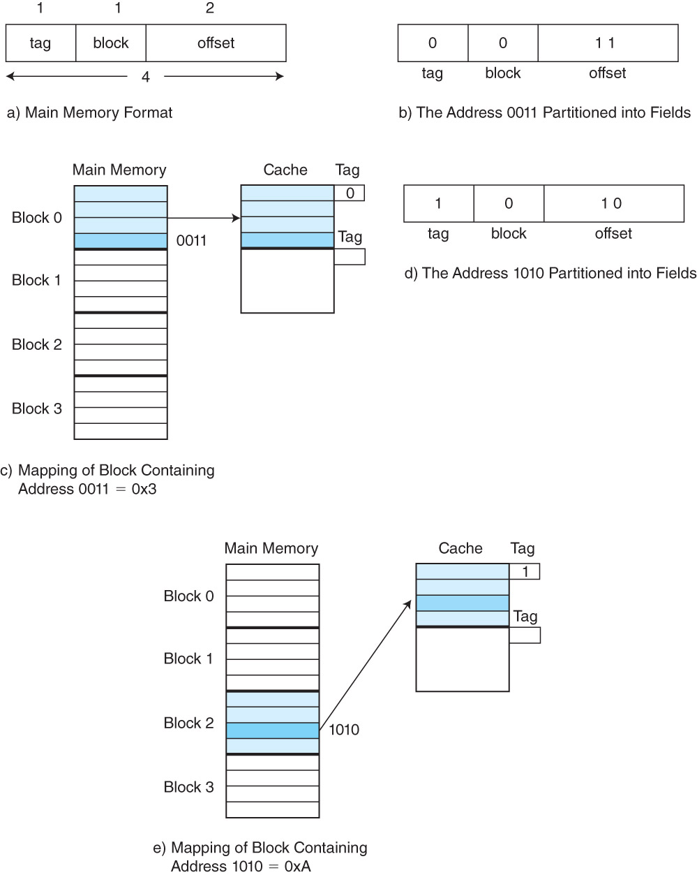
Direct Mapped Cache: Example #3

Slide 23
Direct Mapped Cache: Example #3
Memory address 0011 maps to block 0, offset 3
Note that memory address 1011 also maps to block 0, offset 3
So if the computer looks into block 0 offset 3, how does it know whether the value there came from memory address 0011 or 1011?
Answer: the tag field (0 for 0011 and 1 for 1011). That’s why we need the tag field – to distinguish from multiple blocks that are mapped to the same location in cache

Slide 24
Cache Memory
A question: when the CPU looks in the cache for some value, how do we know that the block which should contain that value actually does contain that value?
Suppose we want to retrieve a word from block 1 of the cache. How do we know that block 1 actually has the word, and not, say, some random garbage data?
Answer: we add another bit to each block called the valid bit which tells us if the block contains valid (actual) data or not
A value of 0 for the valid bit means that the block does not contain valid data
This is called a cache miss, and so we have to go to main memory for the data
A value of 1 for the valid bit means that the block actually contains valid data
This is called a cache hit, and we avoid making a trip to main memory
Our goal is to maximize the cache hit rate, the percentage of time that the cache contains a value that the CPU is looking for

Slide 25
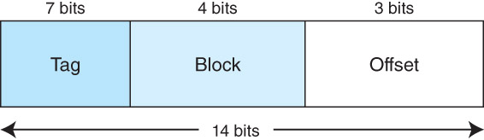
Direct Mapped Cache: Example #4
Assume a byte-addressable memory consists of 2¹⁴ bytes, cache has 16 blocks, and each block has 8 bytes.
The number of memory blocks is: 2¹⁴/2³ = 2¹¹
Each main memory address requires 14 bits. Of this 14-bit address field, the rightmost 3 bits reflect the offset field (why? because 2³ = 8)
We need 4 bits to select a specific block in cache (why?), so the block field consists of the middle 4 bits.
The remaining 7 bits make up the tag field.

Slide 26
Direct Mapped Cache: Example #5
Assume a byte-addressable memory consisting of 16 bytes divided into 8 blocks. Cache contains 4 blocks.
A memory address has 4 bits.
Each block contains 2 bytes
How are the 4 bits of a memory address divided among the block number, offset and tag?
The block number?
2 bits because there are 4 blocks of cache
The offset?
1 bit because we have a byte-addressable memory with 2 bytes per block
The tag?
1 bit after accounting for the block number and offset

Slide 27
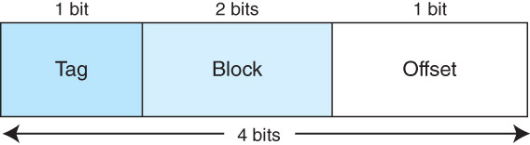
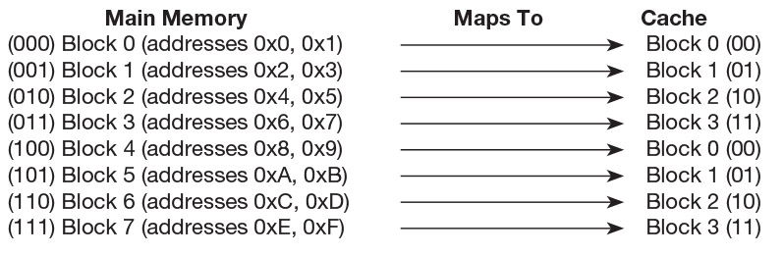
Direct Mapped Cache: Example #5
How are memory addresses mapped to cache blocks?

Slide 28
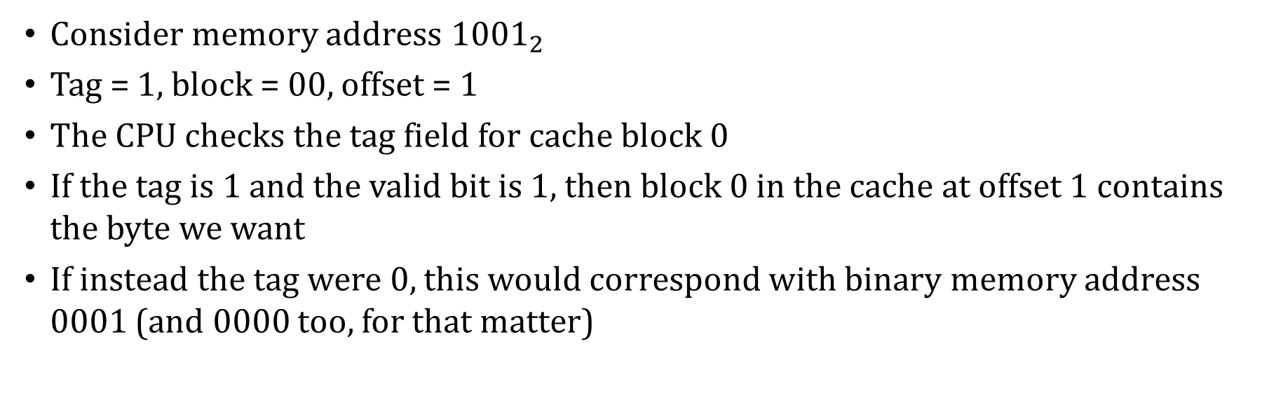
Direct Mapped Cache: Example #5
Consider memory address ${1001}_{2}$
Tag = 1, block = 00, offset = 1
The CPU checks the tag field for cache block 0
If the tag is 1 and the valid bit is 1, then block 0 in the cache at offset 1 contains the byte we want
If instead the tag were 0, this would correspond with binary memory address 0001 (and 0000 too, for that matter)

Slide 29
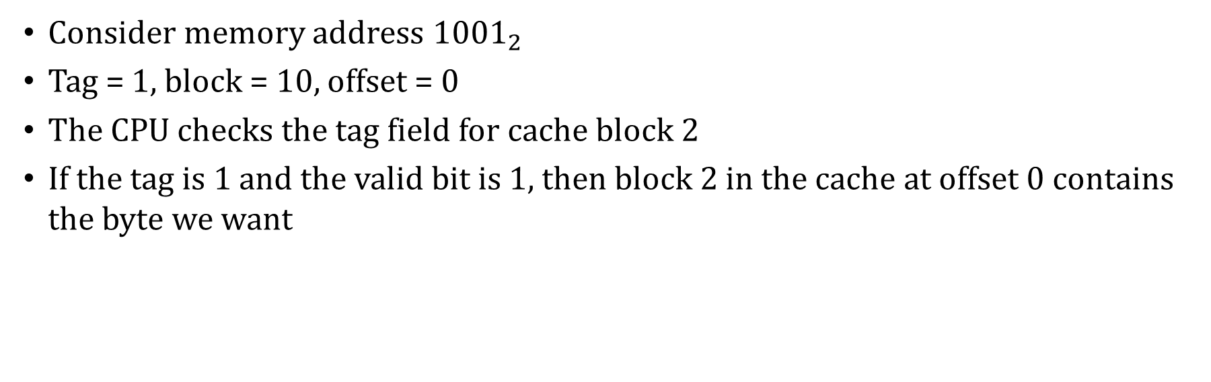
Direct Mapped Cache: Example #5
Consider memory address ${1001}_{2}$
Tag = 1, block = 10, offset = 0
The CPU checks the tag field for cache block 2
If the tag is 1 and the valid bit is 1, then block 2 in the cache at offset 0 contains the byte we want

Slide 30
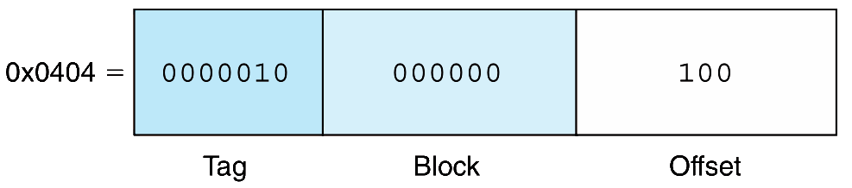
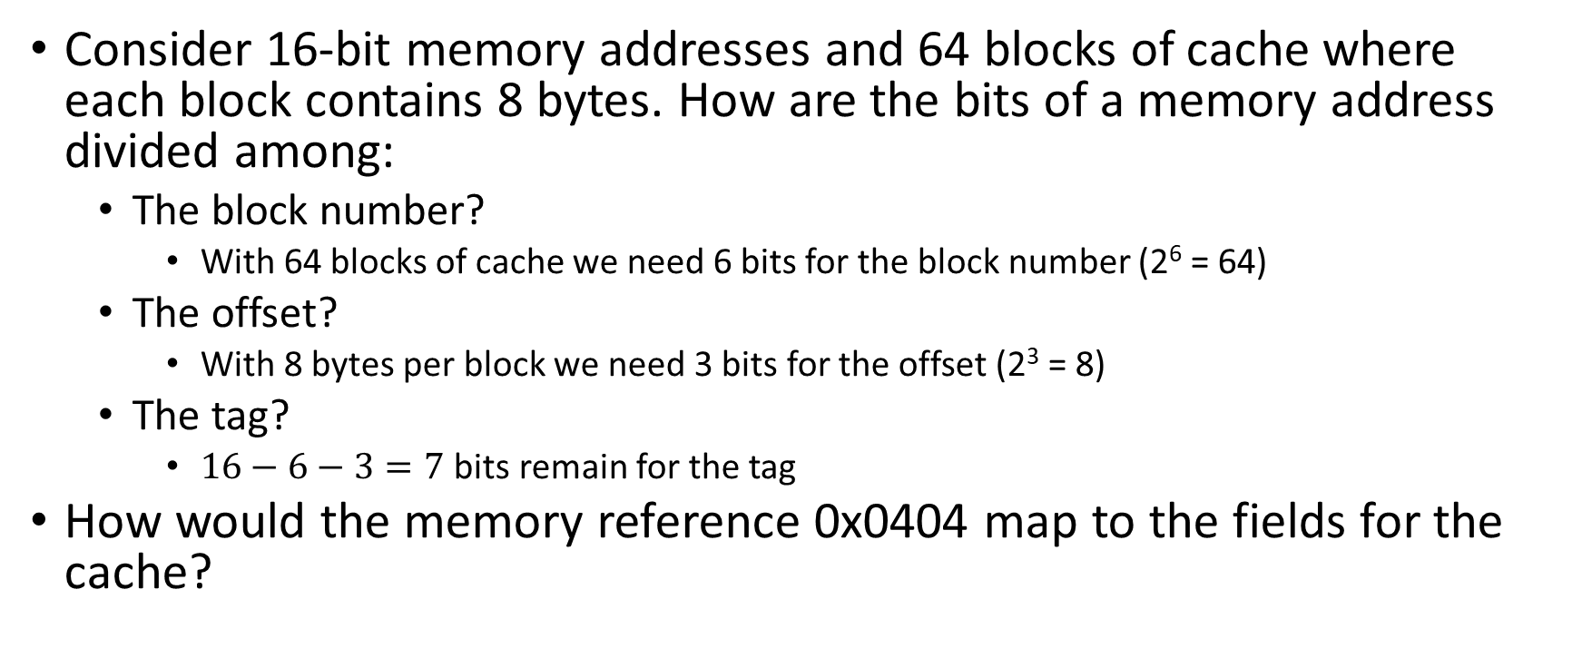
Direct Mapped Cache: Example #6
Consider 16-bit memory addresses and 64 blocks of cache where each block contains 8 bytes. How are the bits of a memory address divided among:
The block number?
With 64 blocks of cache we need 6 bits for the block number (2⁶ = 64)
The offset?
With 8 bytes per block we need 3 bits for the offset (2³ = 8)
The tag?
$16−6−3=7$ bits remain for the tag
How would the memory reference 0x0404 map to the fields for the cache?

Slide 31
Direct Mapped Cache: Example #7
Consider a computer with:
Direct mapped cache with 32 blocks
Each cache block is 16 bytes
2²⁰ bytes of byte-addressable main memory
Questions:
How many blocks of main memory are there?
What is the format of a memory address as seen by the cache (i.e., what are the sizes of tag, block, and offset fields)?
To which cache block will the memory address 0x0DB63 map?

Slide 32
Direct Mapped Cache: Example #7
Consider a computer with:
Direct mapped cache with 32 blocks
Each cache block is 16 bytes
2²⁰ bytes of byte-addressable main memory
Questions:
How many blocks of main memory are there?
Main memory: 2²⁰ bytes
2⁴ bytes per block
2¹⁶ blocks of main memory (2²⁰ / 2⁴)

Slide 33
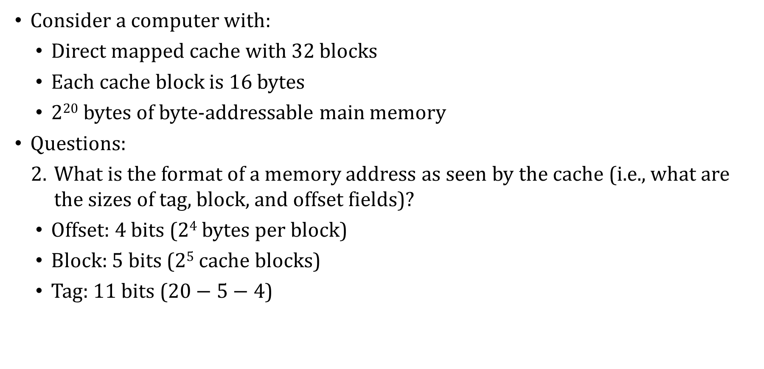
Direct Mapped Cache: Example #7
Consider a computer with:
Direct mapped cache with 32 blocks
Each cache block is 16 bytes
2²⁰ bytes of byte-addressable main memory
Questions:
What is the format of a memory address as seen by the cache (i.e., what are the sizes of tag, block, and offset fields)?
Offset: 4 bits (2⁴ bytes per block)
Block: 5 bits (2⁵ cache blocks)
Tag: 11 bits ($20−5−4$)

Slide 34
Direct Mapped Cache: Example #7
Offset: 4 bits (24 bytes per block)
Block: 5 bits (25 cache blocks)
Tag: 11 bits (20−5−4)
Consider a computer with:
Direct mapped cache with 32 blocks
Each cache block is 16 bytes
2²⁰ bytes of byte-addressable main memory
Questions:
To which cache block will the memory address 0x0DB63 map?
Memory address memory address 0x0DB63 is:
0000 1101 1011 0110 0011₂
00001101101 10110 0011₂
Maps to cache block 10110₂ = 22₁₀

Slide 35
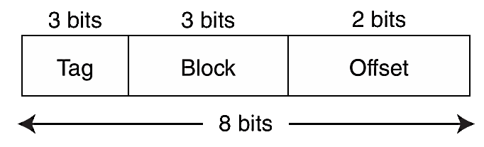
Direct Mapped Cache: Example #8
A byte-addressable computer has an 8-block cache of 4 bytes each
We trace memory accesses in this order: 0x01, 0x04, 0x09, 0x05, 0x14, 0x21, and 0x01
The address format for direct mapped cache is:

Slide 36
Direct Mapped Cache: Example #8
Block | Cache Contents (represented by address) | Tag
0
1
2
3
4
5
6
7

Slide 37
Direct Mapped Cache: Example #8
Address reference: 0x01
Address divided into fields: 000 000 01
Hit or miss? Miss
If we check cache block 000 for the tag 000, we find that it is not there.
So, we copy the data from addresses 0x00, 0x01, 0x02 and 0x03 into cache block 0 and store the tag 000 for that block.

Slide 38
Direct Mapped Cache: Example #8
Block | Cache Contents (represented by address) | Tag
0 | 0x00, 0x01, 0x02, 0x03 | 000
1
2
3
4
5
6
7

Slide 39
Direct Mapped Cache: Example #8
Address reference: 0x04
Address divided into fields: 000 001 00
Hit or miss? Miss
If we check cache block 001 for the tag 000, we find that it is not there.
So, we copy the data from addresses 0x04, 0x05, 0x06 and 0x07 into cache block 1 and store the tag 000 for that block.

Slide 40
Direct Mapped Cache: Example #8
Block | Cache Contents (represented by address) | Tag
0 | 0x00, 0x01, 0x02, 0x03 | 000
1 | 0x04, 0x05, 0x06, 0x07 | 000
2
3
4
5
6
7

Slide 41
Direct Mapped Cache: Example #8
Address reference: 0x09
Address divided into fields: 000 010 01
Hit or miss? Miss
If we check cache block 010 for the tag 000, we find that it is not there.
So, we copy the data from addresses 0x08, 0x09, 0x0A and 0x0B into cache block 2 and store the tag 000 for that block.

Slide 42
Direct Mapped Cache: Example #8
Block | Cache Contents (represented by address) | Tag
0 | 0x00, 0x01, 0x02, 0x03 | 000
1 | 0x04, 0x05, 0x06, 0x07 | 000
2 | 0x08, 0x09, 0x0A, 0x0B | 000
3
4
5
6
7

Slide 43
Direct Mapped Cache: Example #8
Address reference: 0x05
Address divided into fields: 000 001 01
Hit or miss? Hit
If we check cache block 001 for the tag 000, we find that it is there.
We then use the offset value 01 to get the exact byte we need.

Slide 44
Direct Mapped Cache: Example #8
Block | Cache Contents (represented by address) | Tag
0 | 0x00, 0x01, 0x02, 0x03 | 000
1 | 0x04, 0x05, 0x06, 0x07 | 000
2 | 0x08, 0x09, 0x0A, 0x0B | 000
3
4
5
6
7

Slide 45
Direct Mapped Cache: Example #8
Address reference: 0x14
Address divided into fields: 000 101 00
Hit or miss? Miss
If we check cache block 101 for the tag 000, we find that it is not there.
So, we copy the data from addresses 0x14, 0x15, 0x16 and 0x17 into cache block 5 and store the tag 000 for that block.

Slide 46
Direct Mapped Cache: Example #8
Block | Cache Contents (represented by address) | Tag
0 | 0x00, 0x01, 0x02, 0x03 | 000
1 | 0x04, 0x05, 0x06, 0x07 | 000
2 | 0x08, 0x09, 0x0A, 0x0B | 000
3
4
5 | 0x14, 0x15, 0x16, 0x17 | 000
6
7

Slide 47
Direct Mapped Cache: Example #8
Address reference: 0x21
Address divided into fields: 001 000 01
Hit or miss? Miss
If we check cache block 000 for the tag 001, we find that it is not there. Rather, tag 000 is there.
So, we copy the data from addresses 0x20, 0x21, 0x22 and 0x23 into cache block 0 and store the tag 001 for that block.

Slide 48
Direct Mapped Cache: Example #8
Block | Cache Contents (represented by address) | Tag
0 | 0x20, 0x21, 0x22, 0x23 | 001
1 | 0x04, 0x05, 0x06, 0x07 | 000
2 | 0x08, 0x09, 0x0A, 0x0B | 000
3
4
5 | 0x14, 0x15, 0x16, 0x17 | 000
6
7

Slide 49
Direct Mapped Cache: Example #8
Address reference: 0x01
Address divided into fields: 000 000 01
Hit or miss? Miss
If we check cache block 000 for the tag 000, we find that it is not there. Rather, tag 001 is there.
So, we copy the data from addresses 0x00, 0x01, 0x02 and 0x03 into cache block 0 and store the tag 000 for that block.

Slide 50
Direct Mapped Cache: Example #8
Block | Cache Contents (represented by address) | Tag
0 | 0x00, 0x01, 0x02, 0x03 | 000
1 | 0x04, 0x05, 0x06, 0x07 | 000
2 | 0x08, 0x09, 0x0A, 0x0B | 000
3
4
5 | 0x14, 0x15, 0x16, 0x17 | 000
6
7

Slide 51
Direct Mapped Cache: Summary
In summary, direct mapped cache maps main memory blocks in a modular fashion to cache blocks. The mapping depends on:
The number of bits in a main memory address (how many addresses exist in main memory)
The number of blocks in cache (which determines the size of the block field in bits)
How many addresses (either bytes or words) are in a block (which determines the size of the offset field in bits)

Slide 52
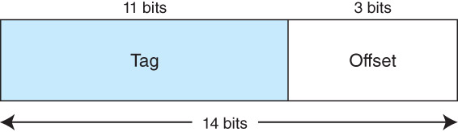
Associative Cache
Suppose instead of placing memory blocks in specific cache locations based on memory address, we could allow a block to go anywhere in cache.
In this way, cache would have to fill up before any blocks are evicted.
This is how fully associative cache works.
A memory address is partitioned into only two fields: the tag and the offset.
Suppose we have 14-bit memory addresses (with byte-addressable memory) and a cache with 16 blocks where each block has 8 bytes. The field format of a memory reference is:
When the cache is searched, all tags are searched in parallel to retrieve the data quickly. This requires special, costly hardware.

Slide 53
Block Replacement Policy
Direct mapped cache evicts a block whenever another memory reference needs that block.
With fully associative cache, we have no such mapping
We need an algorithm to determine which block to evict from the cache.
The block that is evicted is the victim block. But how do we pick a victim?
With fully associative cache, a replacement policy is invoked when it becomes necessary to evict a block from cache.
An optimal replacement policy would be able to look into the future to see which blocks won’t be needed for the longest period of time.
Although it is impossible to implement an optimal replacement algorithm, it is instructive to use it as a benchmark for assessing the efficiency of any other scheme we come up with.

Slide 54
Block Replacement Policy
The replacement policy that we choose depends upon the locality that we are trying to optimize – usually, we are interested in temporal locality.
That is, we want to retain in the cache those blocks we expect to need again soon
A least recently used (LRU) algorithm tracks when a block was last accessed and evicts the block that has been unused for the longest period of time.
The disadvantage of this approach is its complexity: LRU has to maintain an access history for each block, which ultimately slows down the cache.
To implement LRU we need to keep track of the “age” of the block in the cache
First-in, first-out (FIFO) is a different popular cache replacement policy.
In FIFO, the block that has been in the cache the longest, regardless of when it was last used. A special kind of list called a queue is used to track this information.

Slide 55
LRU Block Replacement: Example
Suppose a program makes a sequence of memory references that cause the following memory blocks to be read, in this order: E, A, B, E, D, B, A, C
The CPU’s cache has 4 blocks
Show the state of the cache after each memory block access
Indicate the age of a block by giving the sequence number of when the block was last referenced

Slide 56
LRU Block Replacement: Example
Block access sequence: E, A, B, E, D, B, A, C
Block access sequence: E, A, B, E, D, B, A, C
Block access sequence: E, A, B, E, D, B, A, C
Block access sequence: E, A, B, E, D, B, A, C
E (1)
E (1) | A (2)
E (1) | A (2) | B (3)
E (4) | A (2) | B (3)

Slide 57
LRU Block Replacement: Example
Block access sequence: E, A, B, E, D, B, A, C
Block access sequence: E, A, B, E, D, B, A, C
Block access sequence: E, A, B, E, D, B, A, C
Block access sequence: E, A, B, E, D, B, A, C
E (4) | A (2) | B (3) | D (5)
E (4) | A (2) | B (6) | D (5)
E (4) | A (7) | B (6) | D (5)
C (8) | A (7) | B (6) | D (5)

Slide 58
FIFO Block Replacement: Example
Suppose a program makes a sequence of memory references that cause the following memory blocks to be read: E, A, B, E, D, B, A, C, G, E
The CPU’s cache has 4 blocks and uses FIFO as the replacement policy
Show the state of the cache after each memory block access
Assume the left-hand side of the queue is the head of the queue. Use an arrow to mark the oldest block in the queue.
Empty queue:

Slide 59
FIFO Block Replacement: Example
Block access sequence: E, A, B, E, D, B, A, C, G, E, F
Block access sequence: E, A, B, E, D, B, A, C, G, E, F
Block access sequence: E, A, B, E, D, B, A, C, G, E, F
E
E | A
E | A | B

Slide 60
FIFO Block Replacement: Example
Block access sequence: E, A, B, E, D, B, A, C, G, E, F
Block access sequence: E, A, B, E, D, B, A, C, G, E, F
Block access sequence: E, A, B, E, D, B, A, C, G, E, F
E | A | B
E | A | B | D
E | A | B | D

Slide 61
FIFO Block Replacement: Example
Block access sequence: E, A, B, E, D, B, A, C, G, E, F
Block access sequence: E, A, B, E, D, B, A, C, G, E, F
Block access sequence: E, A, B, E, D, B, A, C, G, E, F
E | A | B | D
C | A | B | D
C | G | B | D

Slide 62
FIFO Block Replacement: Example
Block access sequence: E, A, B, E, D, B, A, C, G, E, F
Block access sequence: E, A, B, E, D, B, A, C, G, E, F
C | G | E | D
C | G | E | F

Slide 63
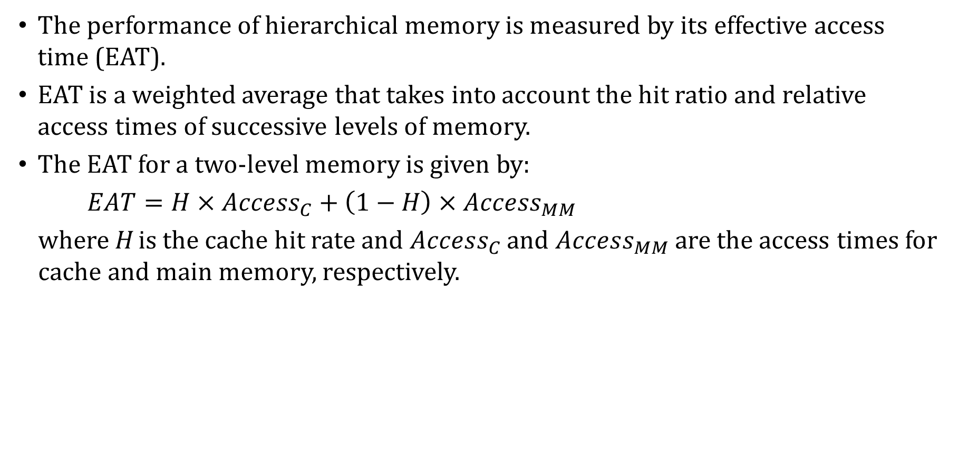
Cache Memory: Effective Access Time
The performance of hierarchical memory is measured by its effective access time (EAT).
EAT is a weighted average that takes into account the hit ratio and relative access times of successive levels of memory.
The EAT for a two-level memory is given by:
$EAT=H×Access_{C}+\left(1−H\right)×Access_{MM}$
where H is the cache hit rate and $Access_{C}$ and $Access_{MM}$ are the access times for cache and main memory, respectively.

Slide 64
Effective Access Time: Example #1
For example, consider a system with a main memory access time of 200ns supported by a cache having a 10ns access time and a hit rate of 99%.
Suppose access to cache and main memory occurs concurrently, as opposed to sequentially.
In this scenario, the CPU initiates requests to cache and main memory simultaneously.
That is, the two requests overlap, so that if the block is not in cache, the request to main memory is already on its way.
The EAT is 0.99(10ns) + 0.01(200ns) = 9.9ns + 2ns = 11.9ns.
Notes:
tst

Slide 65
Effective Access Time: Example #2
If the accesses do not overlap, they must instead happen sequentially
In this scenario, the CPU first checks the cache for the block. If the block is not in the cache, the CPU initiates a request to main memory.
The EAT is 0.99(10ns) + 0.01(10ns + 200ns) = 9.9ns + 2.1ns = 12ns.

Slide 66
Cache Memory
Cache replacement policies must take into account dirty blocks, those blocks that have been updated while they were in the cache.
Dirty blocks must be written back to memory. A write policy determines how this will be done.
There are two types of write policies: write-through and write-back.
Write-through updates cache and main memory simultaneously on every write.
Write-back (also called copyback) updates memory only when the block is selected for replacement.

Slide 67
Cache Memory
The disadvantage of write-through is that memory must be updated with each cache write, which slows down the access time on updates.
This slowdown is usually negligible, because the majority of accesses tend to be reads, not writes.
The advantage of write-back is that memory traffic is minimized, but its disadvantage is that memory does not always agree with the value in cache, causing problems in systems with many concurrent threads of execution.

Slide 68
Cache Memory
The cache we have been discussing is called a unified or integrated cache where both instructions and data are cached.
Many modern systems employ separate caches for data and instructions.
This is called a Harvard cache.
The separation of data from instructions provides better locality, at the cost of greater complexity.
Simply making the cache larger provides about the same performance improvement without the complexity.

Slide 69
Cache Memory
Cache performance can also be improved by adding a small associative cache to hold blocks that have been evicted recently.
This is called a victim cache.
It gives data that was evicted from cache a “second chance” to be used before being sent to memory
A trace cache is a variant of an instruction cache that holds instructions that were already decoded.

Slide 70
Multi-level Cache Memory
Most of today’s small systems employ multilevel cache hierarchies.
The levels of cache form their own small memory hierarchy.
Level 1 cache (~8KB – 64KB) is situated on the processor itself.
Access time is typically about 4ns.
Level 2 cache (~64KB – 2MB) may be on the motherboard, or on an expansion card.
Access time is usually around 15 – 20ns.
In systems that employ three levels of cache, the Level 2 cache is placed on the same die as the CPU (reducing access time to about 10ns)
Accordingly, the Level 3 cache (~2MB – 256MB) refers to cache that is situated between the processor and main memory.

Slide 71
Multi-level Cache Memory
Once the number of cache levels is determined, the next thing to consider is whether data (or instructions) can exist in more than one cache level.
If the cache system used an inclusive cache, the same data may be present at multiple levels of cache.
Strictly inclusive caches guarantee that all data in a smaller cache also exists at the next higher level.
Exclusive caches permit only one copy of the data to be stored somewhere in the multi-level cache.
The tradeoffs in choosing one over the other involve weighing the variables of access time, memory size, and circuit complexity.
Notes:
Strictly cache is design to protect the data by having the redundancy. And the data will be available on all the level of cache.
Exclusive caches is going to have the one copy of data (Slighty chance to loose the data.

Slide 72
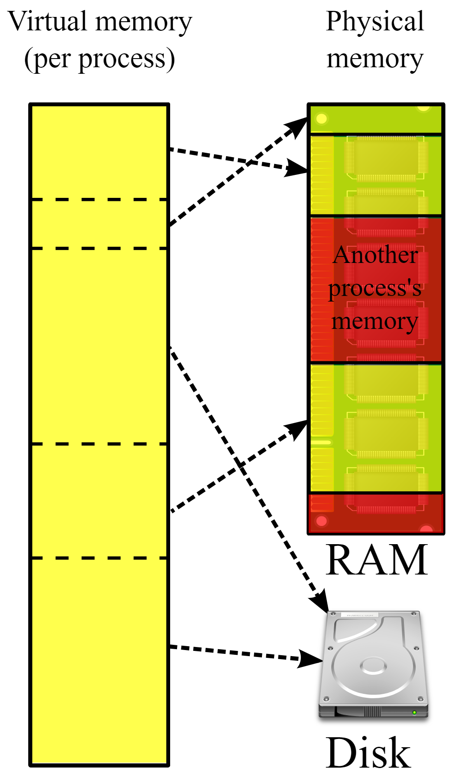
Virtual Memory
Cache memory enhances performance by providing faster memory access speed.
Virtual memory enhances performance by providing greater memory capacity, without the expense of adding main memory.
Instead, a portion of a disk drive serves as an extension of main memory.
If a system uses paging, virtual memory partitions main memory into individually managed page frames, that are written (or paged) to disk when they are not immediately needed.
Notes:
Defining page which is dividing up data into pre-defined page size which is bigger than block

Slide 73
Virtual Memory
Page faults occur when a logical address requires that a page be brought in from disk.
Memory fragmentation occurs when the paging process results in the creation of small, unusable clusters of memory addresses.
Main memory and virtual memory are divided into equal sized pages.
The entire address space required by a process need not be in memory at once. Some parts can be on disk, while others are in main memory.

Slide 74
Virtual Memory
Further, the pages allocated to a process do not need to be stored contiguously – either on disk or in memory.
In this way, only the needed pages are in memory at any time, the unnecessary pages are in slower disk storage.
Information concerning the location of each page, whether on disk or in memory, is maintained in a data structure called a page table
There is one page table for each running program
An example page table is shown on the next slide

Slide 75
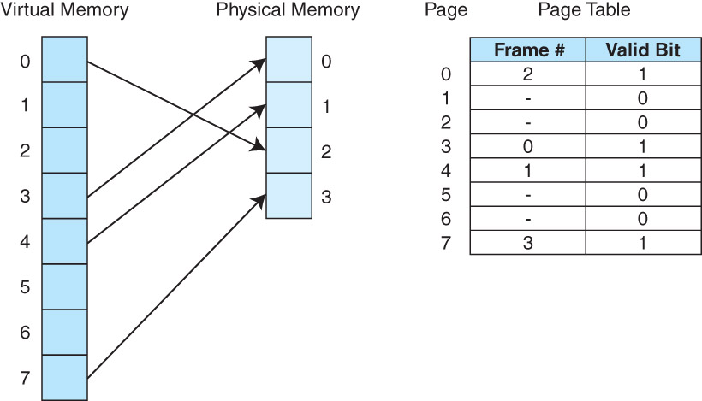
Virtual Memory: Example Page Table

Slide 76
Virtual Memory
When a process generates a virtual address, the operating system translates it into a physical memory address.
To accomplish this, the virtual address is divided into two fields: a page field, and an offset field.
Does this remind you of caches at all?
The page field determines the number of the page that contains that word’s (or byte’s) address, and the offset indicates the location of the word/byte within the page.
The logical page number is translated into a physical page frame through a lookup in the page table.

Slide 77
Virtual Memory
If the valid bit is zero in the page table entry for the logical address, this means that the page is not in memory and must be fetched from disk.
This is a page fault.
If necessary, a page is evicted from memory and is replaced by the page retrieved from disk, and the valid bit is set to 1.
If the valid bit is already 1, the virtual page number is replaced by the physical frame number.
The data is then accessed by adding the offset to the physical frame number.

Slide 78
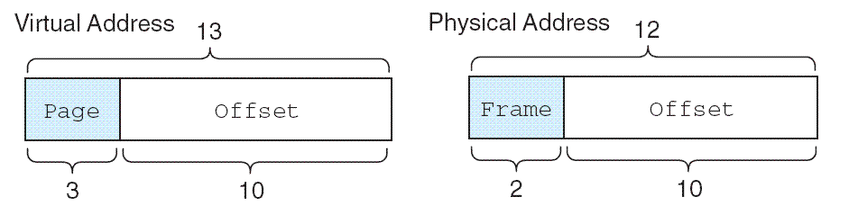
Virtual Memory: Example #1
As an example, suppose a system has a virtual address space of 8K and a physical address space of 4K, and the system uses byte addressing. A page is 1K in size
Thus, we have 2¹³/2¹⁰ = 2³ virtual pages.
A virtual address has 13 bits (8K = 2¹³) with 3 bits for the page field and 10 for the offset, because the page size is 1024.
A physical memory address requires 12 bits, the first two bits for the page frame and the trailing 10 bits the offset.

Slide 79
Virtual Memory: Example #1
The offset field widths must be the same because the pages and page frames are always the same size
But the numbers of pages and frames can differ, which is why the page and frame fields could be different lengths

Slide 80
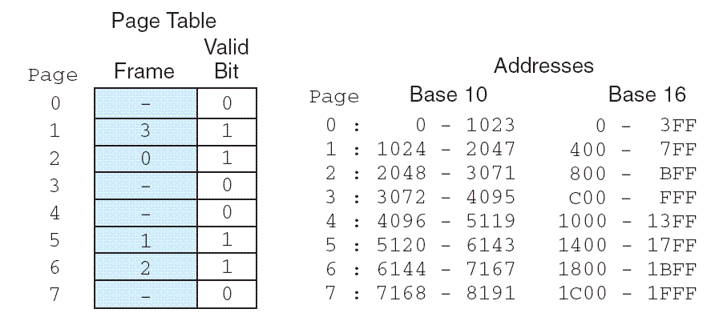
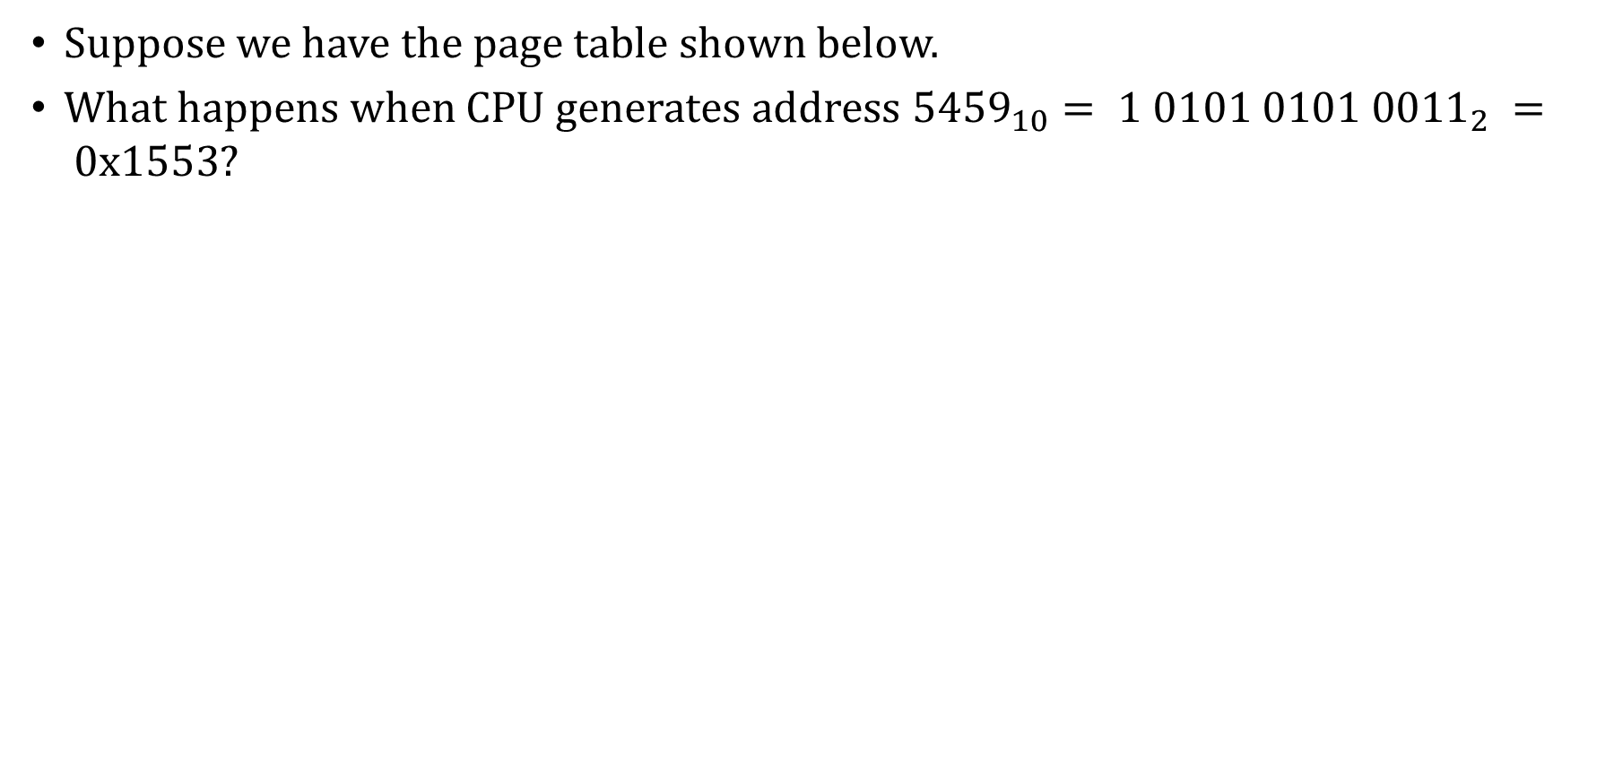
Virtual Memory: Example #2
Suppose we have the page table shown below.
What happens when CPU generates address ${5459}_{10}= 1 0101 0101 {0011}_{2} = 0x1553?$

Slide 81
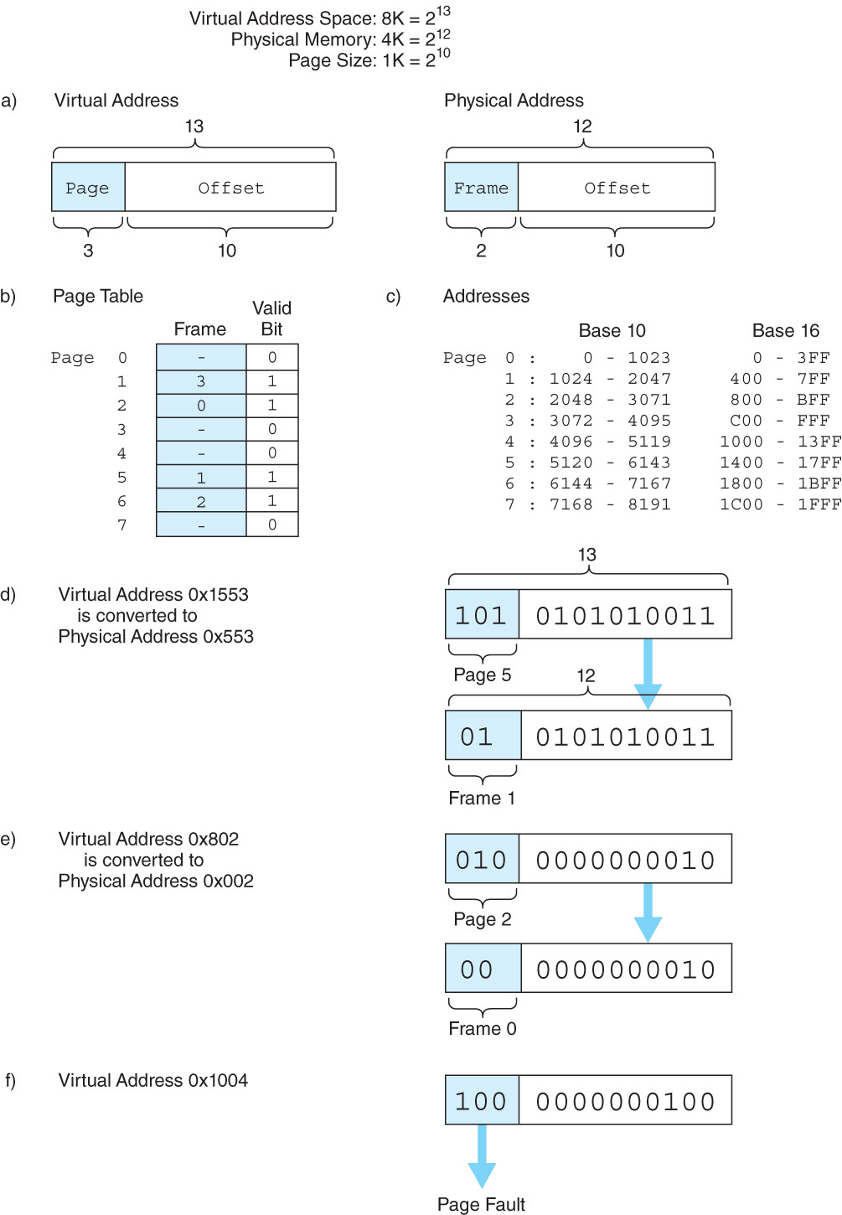
Virtual Memory: Example #2
We have 13-bit addresses with 3-bit page numbers and 10-bit offsets
The virtual address is 1 0101 0101 0011₂ = 101 0101010011₂
The high-order 3 bits of the virtual address, 101 (5₁₀), provide the page number in the page table.

Slide 82
Virtual Memory: Example #2
The address 101 0101010011₂ is converted to physical address 01 0101010011₂ = 0101 0101 0011₂ = 0x553 because the page field 101₂ is replaced by frame number 01₂ through a lookup in the page table.

Slide 83
Virtual Memory: Example #3
What happens when the CPU generates address 1000000000100₂?
100 0000000100₂, which corresponds with page #4. Page fault.

Slide 84
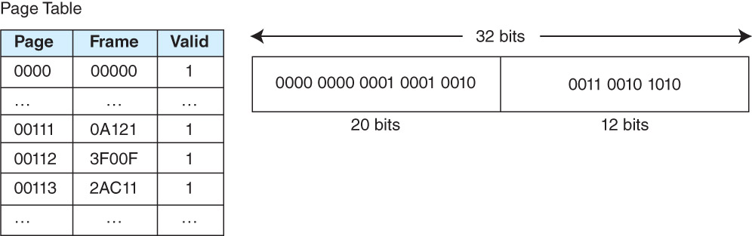
Virtual Memory: Example #4
A computer has 32-bit virtual addresses, a page size of 4 KB and 1 GB of physical RAM
Convert virtual address 0x0011232A to a physical address
A partial page table is given below

Slide 85
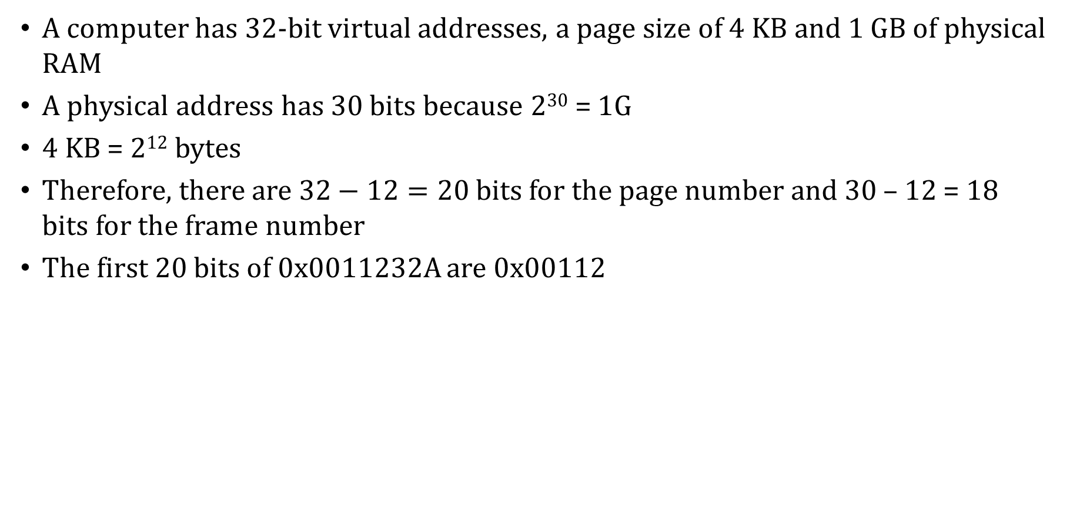
Virtual Memory: Example #4
A computer has 32-bit virtual addresses, a page size of 4 KB and 1 GB of physical RAM
A physical address has 30 bits because 2³⁰ = 1G
4 KB = 2¹² bytes
Therefore, there are $32−12=20$ bits for the page number and 30 – 12 = 18 bits for the frame number
The first 20 bits of 0x0011232A are 0x00112

Slide 86
Virtual Memory: Example #4
The first 20 bits of 0x0011232A are 0x00112
This page is stored in 18-bit frame # 0x3F00F
Append the 12-bit offset 0x32A to obtain physical address 0x3F00F32A

Slide 87
Virtual Memory: Effective Access Time
Effective access time (EAT) actually takes all levels of memory into consideration, not just cache and memory
The formula we explored earlier would have to be expanded a bit to include more than two levels of memory
Thus, virtual memory is also a factor in the calculation, and we also have to consider page table access time.
For each memory access generated by the CPU there must be two physical memory accesses: one to the page table and one to the actual data

Slide 88
Virtual Memory: Example #5
Suppose a main memory access takes 200ns, the page fault rate is 1%, and it takes 10ms to load a page from disk. We have: EAT = 0.99(200ns + 200ns) + 0.01(10ms) = 396 ns + 100000 ns =100,396 ns.
Even if there were no page faults, the EAT would still be 1.0(200ns + 200ns) = 400ns
Because page tables are read constantly, it makes sense to keep them in a special cache called a translation look-aside buffer (TLB).
TLBs are a special associative cache that stores the mapping of virtual pages to physical pages so as to avoid consulting the page table.

Slide 89
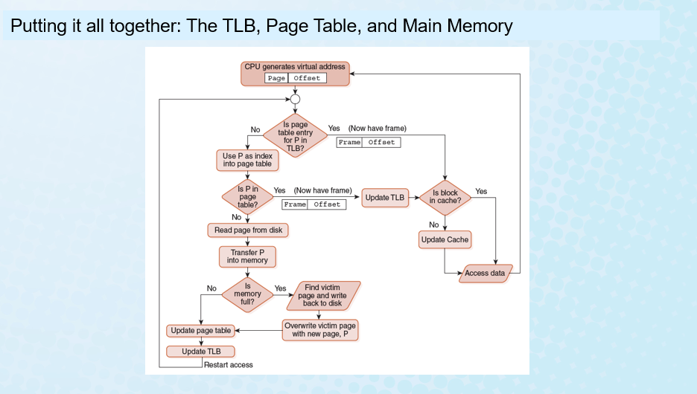

Slide 90
Segmentation
Another approach to virtual memory is the use of segmentation.
Instead of dividing memory into equal-sized pages, virtual address space is divided into variable-length segments, often under the control of the programmer.
A segment is located through its entry in a segment table, which contains the segment’s starting memory location and a bounds limit that indicates its size.
A program can be given several segments, depending on needs. Segmentation makes it easier for the program to manage, protect and share data among running programs.

Slide 91
Fragmentation
Both paging and segmentation can cause fragmentation.
Paging is subject to internal fragmentation because a process may not need the entire range of addresses contained within the page. Thus, there may be many pages containing unused fragments of memory.
Segmentation is subject to external fragmentation, which occurs when contiguous chunks of memory become broken up as segments are allocated and deallocated over time.

Slide 92
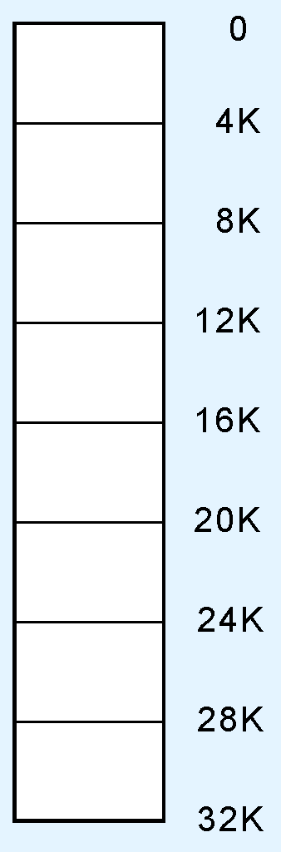
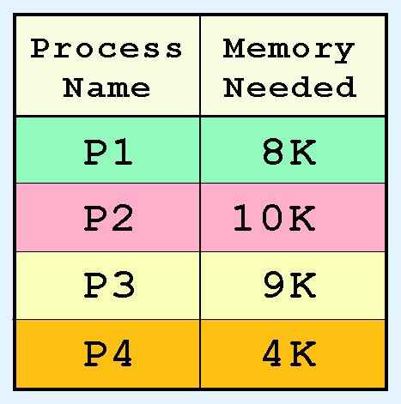
Fragmentation: Example #1
Consider a small computer having 32 KB of memory.
The 32 KB memory is divided into 8 page frames of 4 KB each.
A schematic of this configuration is shown at the right.
The numbers at the right are memory frame addresses.
Suppose there are four processes (programs) waiting to be loaded into the system with memory requirements as shown in the table.
We observe that these processes require 31K of memory.

Slide 93
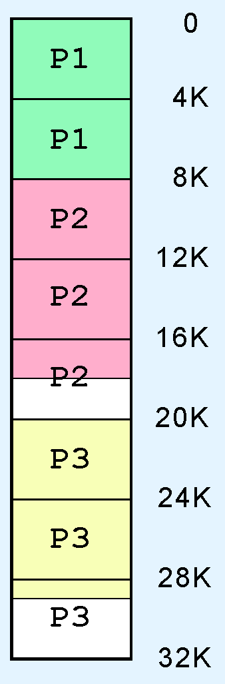
Fragmentation: Example #1
When the first three processes are loaded, memory looks like this:
All of the frames are occupied by three of the processes.
Despite the fact that there are enough free bytes in memory to load the fourth process, P4 has to wait for one of the other three to terminate, because there are no unallocated (free) frames.
This is an example of internal fragmentation.

Slide 94
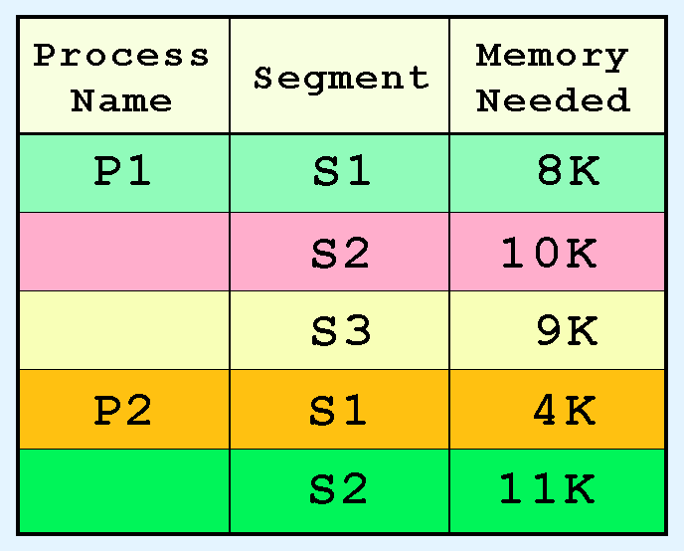
Fragmentation: Example #2
Suppose that instead of frames, our 32KB system uses segmentation.
The memory segments of two processes is shown in the table below
The segments can be allocated anywhere in memory.

Slide 95
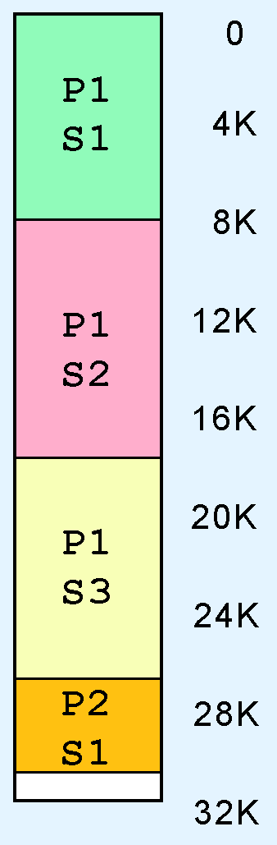
Fragmentation: Example #2
All of the segments of P1 and one of the segments of P2 are loaded as shown at the right.
Segment S2 of process P2 requires 11 KB of memory, and there is only 1 KB free, so it waits.

Slide 96
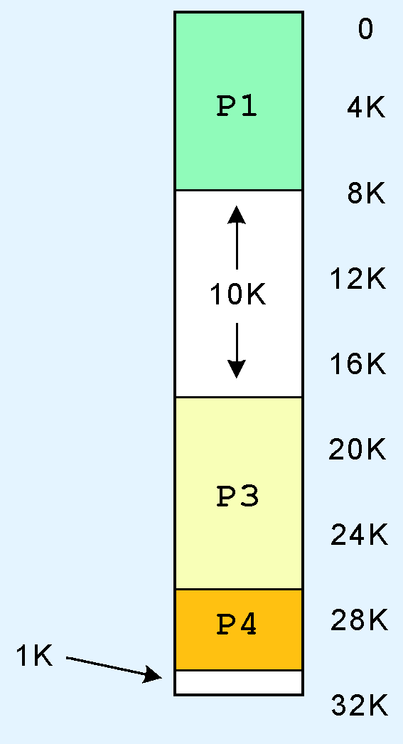


Fragmentation: Example #2
Eventually, Segment 2 of Process 1 is no longer needed, so it is unloaded, giving 11 KB of free memory.
But Segment 2 of Process 2 cannot be loaded because the free memory is not contiguous.

Slide 97
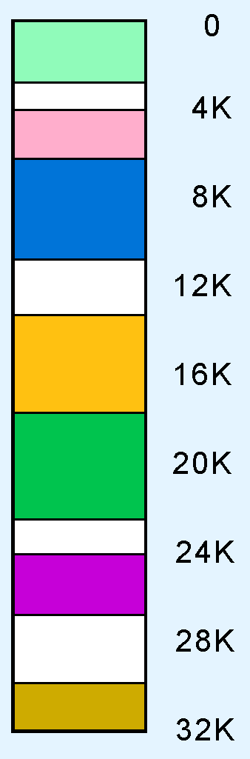
Fragmentation
Over time, the problem gets worse, resulting in small unusable blocks scattered throughout physical memory.
This is an example of external fragmentation.
Eventually, this memory is recovered through compaction, and the process starts over.

Slide 98
A Real-World Example: Pentium Architecture
The Pentium architecture supports both paging and segmentation, and they can be used in various combinations including unpaged unsegmented, segmented unpaged, and unsegmented paged.
The processor supports two levels of cache (L1 and L2), both having a block size of 32 bytes.
The L1 cache is next to the processor, and the L2 cache sits between the processor and memory.
The L1 cache is in two parts: and instruction cache (I-cache) and a data cache (D-cache).

Slide 99
Virtual Memory
Large page tables are cumbersome and slow, but page operations are fast because all pages are the same, small size. Segmentation allows fast access to the segment table, but segment loading is labor-intensive.
Paging and segmentation can be combined to take advantage of the best features of both by assigning fixed-size pages within variable-sized segments.
Each segment has a page table. This means that a memory address will have three fields, one for the segment, another for the page, and a third for the offset.

Slide 100
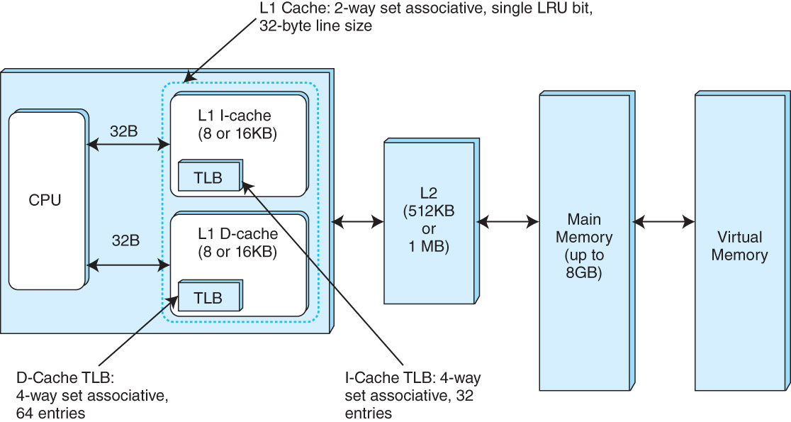
A Real-World Example: Pentium Architecture

